Slide 1
STAT 628 Group 8 Preliminary Analysis Presentation
Shengwen Yang
Haoyue Shi
Yuyang He

Slide 2
TOP 10 PIZZA CHAINS IN THE US
Goal and Data cleaning
Exploratory Data Analysis
Limitation and Future Directions

Slide 3
Introduction
We are interested in large pizza chains.
From a report* in the internet, we find top 10 pizza chains in the US in 2020.
*10 largest pizza chains in the US. Zippia. (n.d.). Retrieved November 18, 2021, from https://www.zippia.com/advice/largest-pizza-chains/.

Slide 4
Goal
Focus on top 10 pizza chains in the US.
Why top 10 pizza chain restaurants are different based on the reviews?

Slide 5
Data Cleaning
Original Data: About 8.64 million reviews and 160 thousand business
Goal: Explore businesses belongs to top 10 pizza chains in the US and gather insights about these businesses through reviews.

Slide 6
Data Cleaning
Method: Filter businesses with keywords which belong to names of top 10 pizza chains in the US.
Final Data: About 398 thousand reviews from 3890 businesses in 10 brands with chains’names, users’stars, attributes, and review_counts.

Slide 7
Exploratory Data Analysis
Analyze Raw Data and Background Information
Extract Insight Features from Word Frequencies
Sentiment Analysis on Features

Slide 8
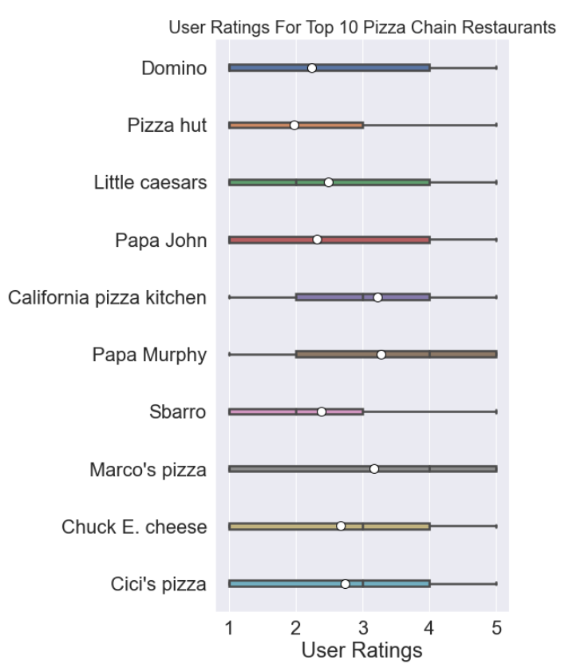
Analyze Raw Data
Get Statistics of Users’ Review Stars
Visulize them in box plot

Slide 9
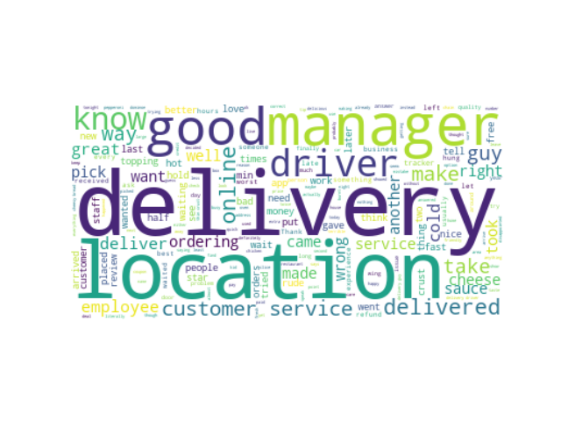
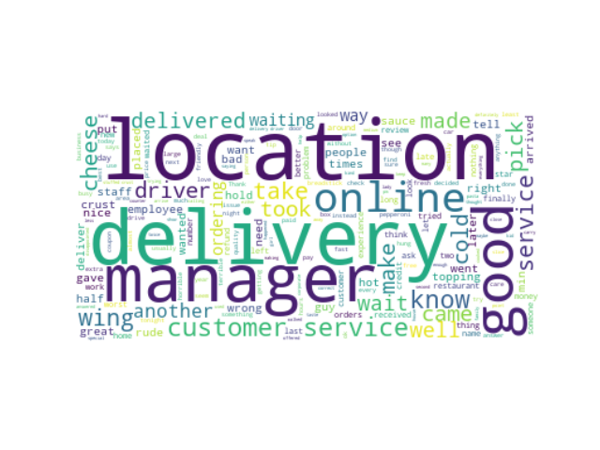
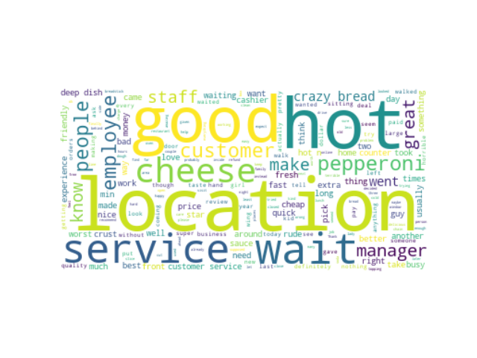
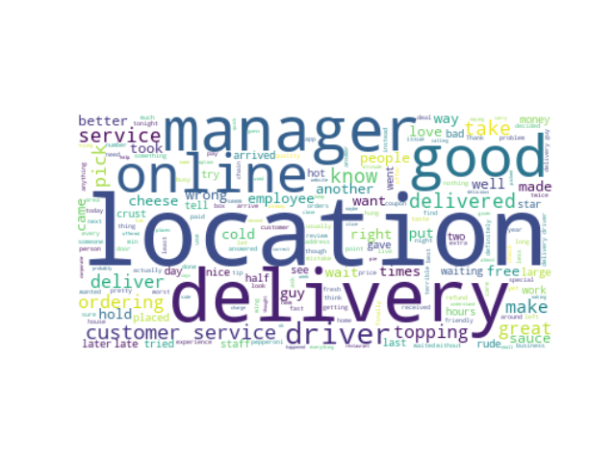
Extract Insight Features
Draw Word Clouds
Extract Important Features
Domino’s
Pizza Hut
Little Caesars
Papa John’s

Slide 10
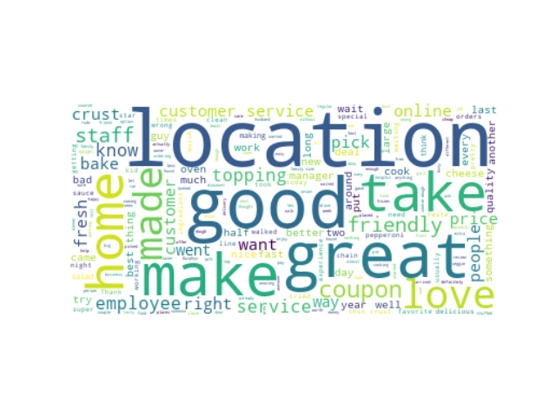
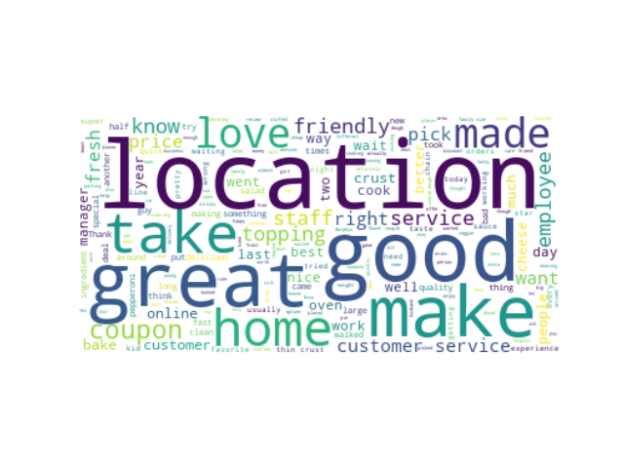
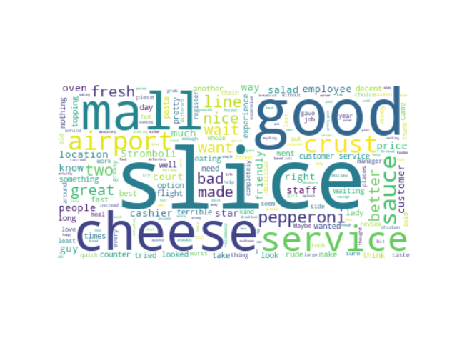
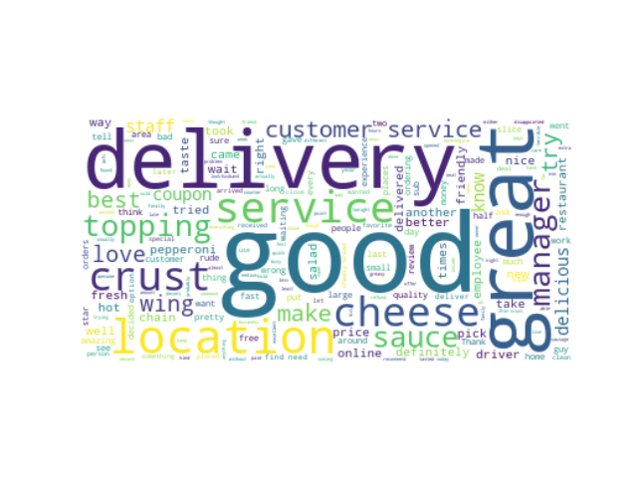
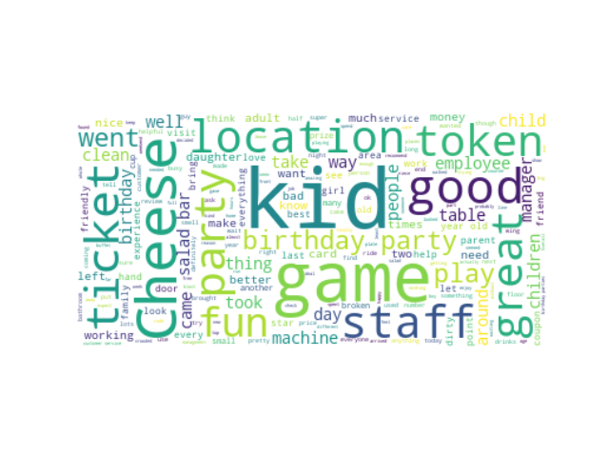
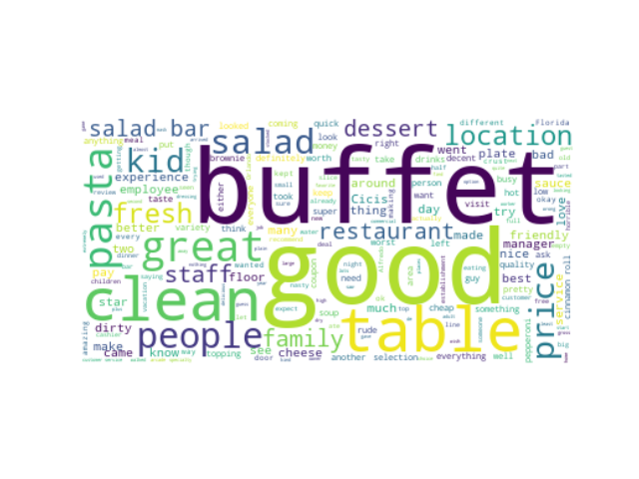
California Pizza Kitchen
Papa Murphy’s
Sbarro
Marco’s Pizza
Chunke E. Cheese
Cici’s Pizza

Slide 11
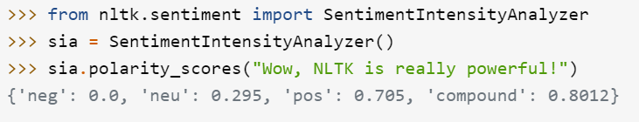
Sentiment Analysis on Features
Extract sentences from reviews with important features
Analyze each sentence’s sentiment level by Nltk packages in python
Calculate the average positive sentiment score for eah features
*
* Real Python. (2021, September 24). Sentiment analysis: First steps with Python's NLTK library. Real Python. Retrieved November 18, 2021, from https://realpython.com/python-nltk-sentiment-analysis/.

Slide 12
 | Domino’s Pizza | Pizza Hut | Little Caesars | Papa John’s | California Pizza Kitchen | Papa Murphys | Sbarro | Marco’s Pizza | Chuck E. Cheese | Cici’s Pizza
Stars | 2.239 | 1.981 | 2.483 | 2.320 | 3.231 | 3.279 | 2.386 | 3.170 | 2.678 | 2.738
Delivery | 0.075 | 0.061 | 0.095 | 0.078 | 0.107 | 0.131 | 0.115 | 0.093 | 0.063 | 0.206
Location | 0.101 | 0.087 | 0.124 | 0.097 | 0.147 | 0.142 | 0.124 | 0.131 | 0.161 | 0.273
Service | 0.129 | 0.12 | 0.158 | 0.137 | 0.214 | 0.252 | 0.116 | 0.187 | 0.172 | 0.133

Slide 13
Limitations
Words: use default stopwords /lemmatization not done
Ignore: shop’s attributes/users’ information
Sentiment analysis: use long sentence may influence the accuracy
“Not shop’s fault”: “The delivery took a while, but that's because GrubHub is terrible, not Chuck E”

Slide 14
Future Directions
Words:
add and subject words for stopwords
use other index to represent importance, such as tf-idf
do lemmatization
Ignore: use other information to help filter review
for example, keep reviews from yelp’s elite
Sentiment analysis: use shorter sentences

Slide 15
Future Directions
Find better and “detailed” words in each feature: For example, use “fast” and “slow” instead of “delivery”
Using statistical tests to find the correlations between words and ratings
Choose kernel words and do a SLR. Ratings ~ intercept + words

Slide 16
THANK YOU
Shengwen Yang
Haoyue Shi
Yuyang He

